Slide 1

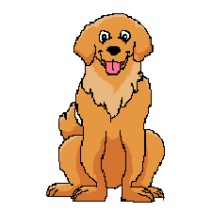
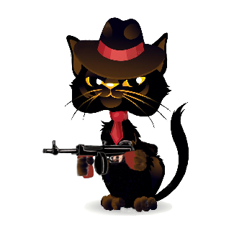

Bone rescue
Prototype Presentation
Ezequiel Flores Schmelensky

Slide 2
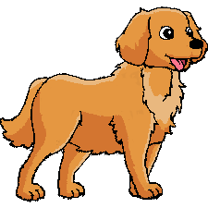
Overview
This game is about a golden retriever dog whose main objective is to recover its bone, the protagonist will run through a large living room to reach its prize (a bone), however, the animal will have to sort several obstacles such as armchairs, lamps, tables, etc. Another level of difficulty are enemies, they are spiders, doves, cats, and final boss that is a big cat who throw bowling balls.
Map scrolling will be top/down, nevertheless, once the maximum top is reached the screen will keep in that position until the boss is defeated, or the dog loses its all health. The main character will have bark powers, which will be 3 waves in mouse direction. They could beat enemies. In addition, some power-ups will be left randomly by enemies to help the protagonist to rescue its bone.

Slide 3
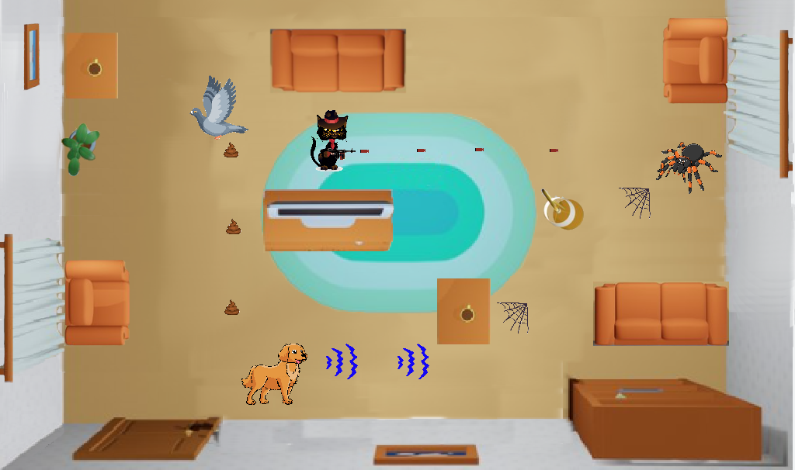
Game Play
UP, DOWN, LEFT, RIGHT movements
Top/Down scroll
Obstacles
3 initial enemies and Big boss
Barking powers
3 Pick-ups types

Slide 4
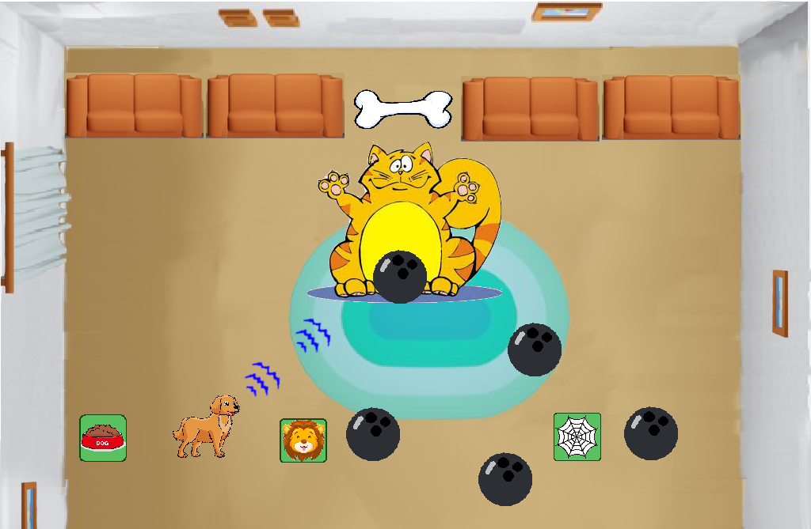
Final Boss

Slide 5
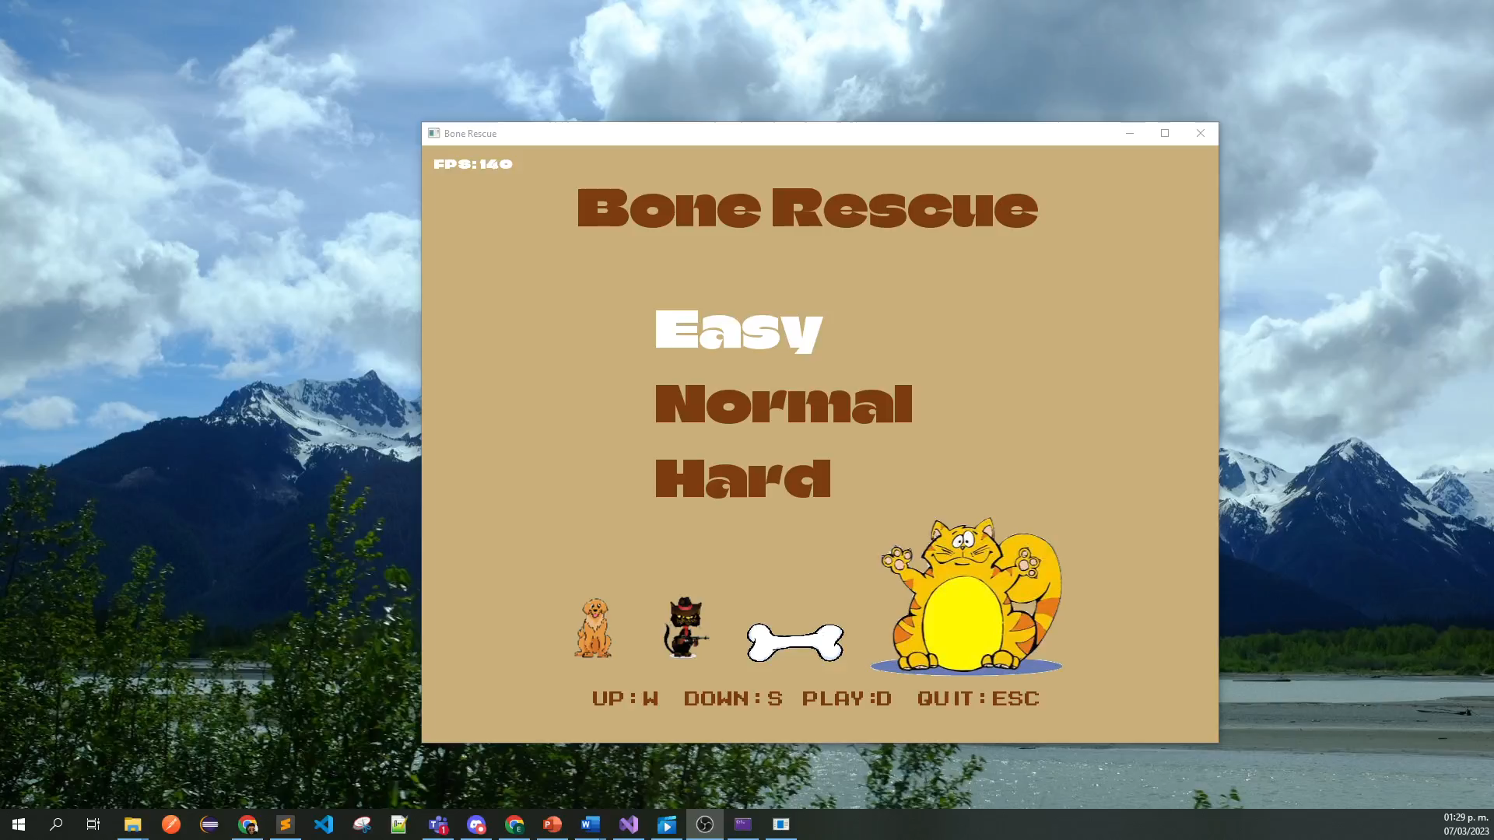
Demo

Slide 6
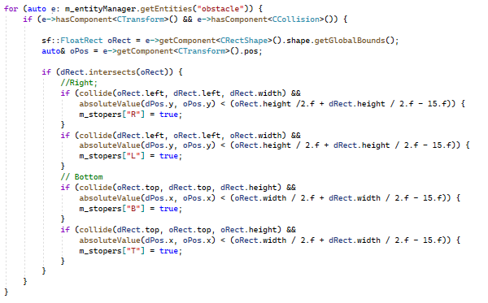
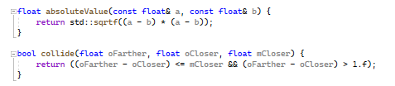
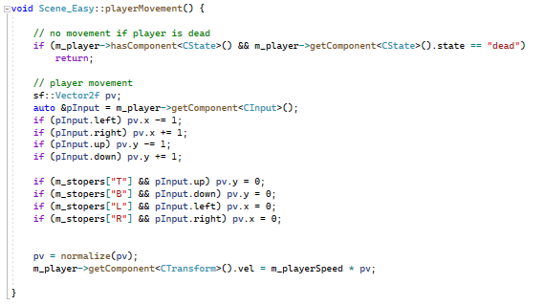
Code review

Slide 7
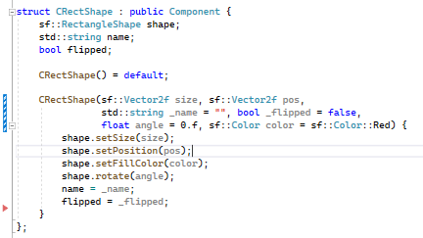
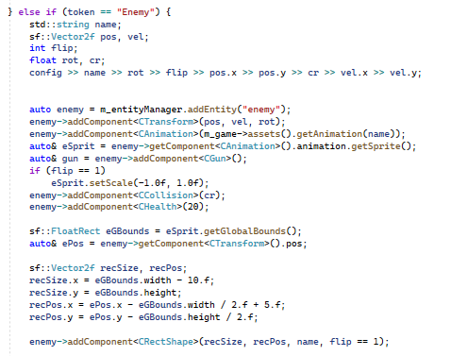
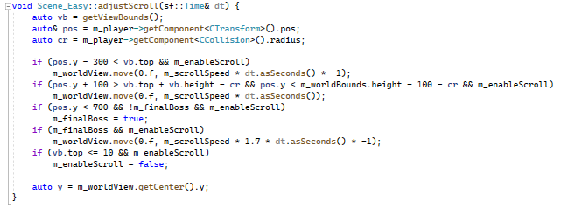
Code review

